Slide 1
E-commerce
Commerce refers to all the activities the purchase and sales of goods or services.
Marketing, sales, payment, fulfillment, customer service
Electronic commerce is doing commerce with the use of computers, networks and commerce-enabled software (more than just online shopping)

Slide 2
E-commerce
E-commerce involves
Digitally enabled commercial transactions between organizations and individuals.
Digitally enabled transactions include all transactions mediated by digital technology
Commercial transactions involve the exchange of value across organizational or individual boundaries in return for products or services

Slide 3
E-commerce
E-commerce
is the use of electronic communications and digital information processing technology in business transactions to create, transform, and redefine relationships for value creation between or among organizations, and between organizations and individuals

Slide 4
E-business
E-business involves
Digital enablement of transactions and processes within a firm, involving information systems under the control of the firm
E-business does not involve commercial transactions across organizational boundaries where value is exchanged

Slide 5
E-business
The transformation of an organization’s processes to deliver additional customer value through the application of technologies, philosophies and computing paradigm of the new economy.
Three primary processes are enhanced in e-business
Production processes,
Customer-focused processes,
Internal management processes,

Slide 6
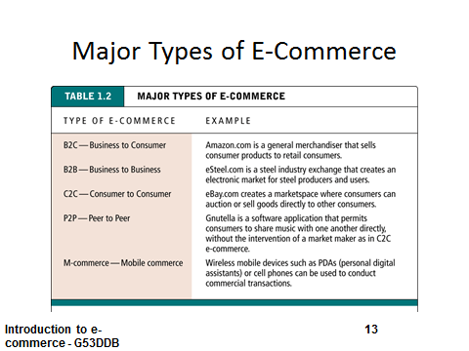

Slide 7
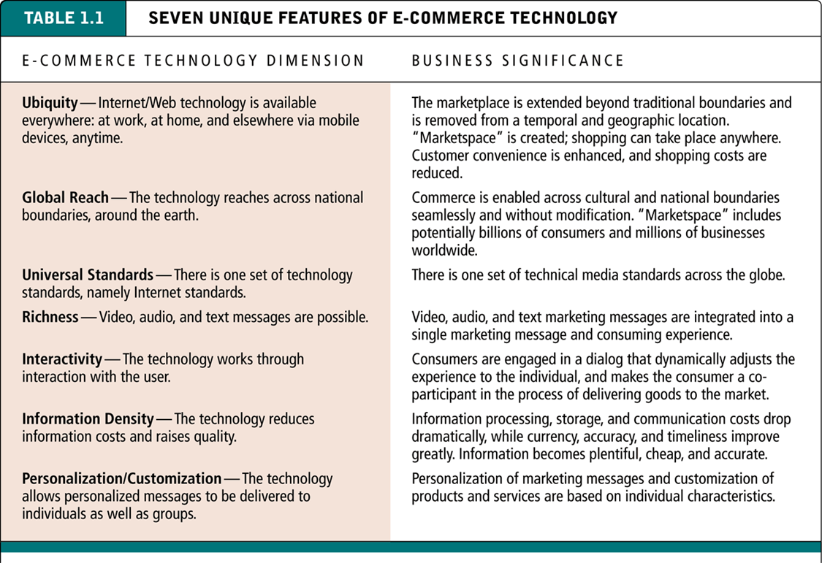

Slide 8
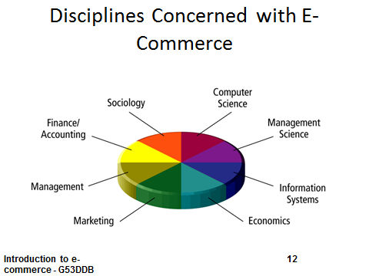

Slide 9
History
1970s: Electronic Funds Transfer (EFT)
Used by the banking industry to exchange account information over secured networks
Late 1970s and early 1980s: Electronic Data Interchange (EDI) for e-commerce within companies
Used by businesses to transmit data from one business to another
1990s: the World Wide Web on the Internet provides easy-to-use technology for information publishing and dissemination
Cheaper to do business (economies of scale)
Enable diverse business activities (economies of scope

Slide 10
Process of e- commerce
Attract customers
Advertising, marketing
Interact with customers
Catalog, negotiation
Handle and manage orders
Order capture
Payment
Transaction
Fulfillment (physical good, service good, digital good)
React to customer inquiries
Customer service
Order tracking

Slide 11
Key drivers
1.Technological factors
2.Political factors
3. Social factors
4. Economic factors

Slide 12
1.Technological factors
Telecommunications infrastructure
Backbone infrastructure and architecture
Industry players and competition
Pricing
Internet service providers
Ownership (private or public sector)
Access to new technology developments
Bandwidth
Speed of development and implementation of new technology by industry sector

Slide 13
2. Political factors
Number and type of government incentives and programmes to support the use and development of new technology
Legislation – number and type of supportive or restrictive laws and policies that govern electronic data, contacts and financial transactions. For example,laws that recognise and enforce the validity of electronic documentation,
contracts and transactions in a court of law; the validation of digital signatures; the legal usage of electronic security measures such as encryption
Public policies – whether government supports the growth of electronic transactions and processes. For example, filing tax returns to the Inland Revenue electronically, the national education curriculum and training

Slide 14
3. Social factors
Skills of workforce
Number of users on-line
Penetration rate of PCs
Level of education; computer literacy and IT skills
Culture of technophilia – a willingness and ability to adopt new technology
and the speed at which technology achieves critical mass as in Japan

Slide 15
4.Economic factors
Economic growth – GDP
Average income
Cost of technology (hardware and software)
Cost of access to telecommunications infrastructure – pricing structures and rates
Commercial infrastructure – advancement of banking sector; payment systems
Innovative business models

Slide 16
Advantages
Increased sales
Reach narrow market segments in geographically dispersed locations
Create virtual communities
Decreased costs
Handling of sales inquiries
Providing price quotes
Determining product availability
Being in the space

Slide 17
Disdvantages
Loss of ability to inspect products from remote locations
Rapid developing pace of underlying technologies
Difficult to calculate return on investment
Cultural and legal impediments

Slide 18
exercise
The third law of newton state when there is a force, then there is equal but apposite force resisting it
In light of e-commerce explain the above statemen

